Slide 1

DEPARTMENT OF COMPUTER SCIENCE AND ENGINEERING
Project Name: Smart Water Fountain
Team Name: Proj_224781_Team_2
Team Members:
NISHAN K M (113321104068)
PARAMESWARAN J (113321104069)
PATURU SUNEEL CHOWDARY (113321104072)
PAVANKUMAR V (113321104073)

Slide 2
PROJECT
Smart water fountains are a modern and technologically advanced version of traditional water fountains. They incorporate various sensors, data analysis, and connectivity features to provide improved functionality, efficiency, and user experience.
Smart Water Fountain is a technology that can be integrated into the Smart City ecosystem with sensors that use real-time data analysis to monitor water quality and flow rate.
Park, garden, forest, etc. It provides drinkable water service in areas, and provides access to water without touching thanks to the foot pedal.

Slide 3
AI FOR SMART WATER FOUNTAINS
1.Water Quality Monitoring: AI can be used to continuously monitor water quality in the fountain. Sensors can detect parameters such as pH levels, turbidity, and chemical contaminants. AI algorithms can analyze the data in real-time and trigger alerts or adjustments if water quality falls below acceptable levels.
2.User Interaction: AI can enhance the user experience by enabling voice commands or touchless interfaces. Users can request specific water features or adjust settings without physical contact. Facial recognition technology can also personalize interactions by recognizing regular users and adjusting fountain settings to their preferences.
3.Remote Monitoring and Control: AI-enabled smart water fountains can be remotely monitored and controlled via a mobile app or a centralized system. This is particularly useful for property managers or maintenance teams to ensure that fountains are functioning correctly.
4.Water Treatment: AI can assist in water treatment processes by optimizing chemical dosages, filtration, and disinfection methods. It can ensure that the water remains clean and safe for users.
5. Predictive Maintenance: AI can predict when components of the fountain, such as pumps or filters, are likely to fail based on historical data and real-time sensor readings. This allows for proactive maintenance to prevent downtime and costly repairs.

Slide 4
ADS FOR SMART WATER FOUNTAINS
Stay Hydrated, Stay Smart :
Visual: Show a sleek and modern smart water fountain with an intuitive touchless interface.
Voiceover: "Experience the future of hydration with our Smart Water Fountain. Stay refreshed and connected with touchless technology. Stay hydrated, stay smart."
Revolutionize Your Workspace :
Visual: Show a smart water fountain in a corporate office setting, with professionals refilling their bottles.
Voiceover: "Transform your workplace with the Smart Water Fountain. Boost productivity and well-being. It's not just water; it's innovation."
Eco-Friendly and Efficient :
Visual: Highlight the water conservation features of the fountain, adjusting water flow based on foot traffic.
Voiceover: "Conserve water with our Smart Fountain. AI technology adapts to your needs, reducing waste. It's eco-friendly and efficient."
Health Meets Technology :
Visual: Showcase the water quality monitoring and filtration features, with a focus on clean and pure water.
Voiceover: "Health and technology unite in our Smart Water Fountain. Pure water, advanced filtration, and real-time monitoring. Because your well-being matters."

Slide 5
DAC FOR SMART WATER FOUNTAINS
Flow Control: A DAC can be used to control the flow rate of water in the fountain. By converting digital control signals into analog voltage or current, the DAC can regulate the speed of water pumps or valves, allowing you to adjust the water flow as desired. This can be done to create various fountain effects, from gentle trickles to powerful sprays.
Temperature Control: Some smart water fountains incorporate features like heating or cooling the water to maintain a specific temperature. A DAC can be used to control the heating or cooling elements within the system to maintain the desired water temperature.
LED Lighting Control: Smart water fountains often include LED lighting to create captivating visual effects. A DAC can be employed to control the color and intensity of the LED lights, allowing for dynamic and customizable lighting displays.
Water Jet Control: For fountains with adjustable water jets, a DAC can be used to precisely control the height, angle, and pattern of the water jets. This can create a variety of water patterns and visual effects.
Synchronization and Automation: A DAC can be integrated into a smart control system, allowing for automation and synchronization with other smart devices, such as sensors, timers, or remote control apps. This enables you to program the water fountain to operate at specific times or in response to certain events, such as changing weather conditions or special occasions.
Water Quality Monitoring: Some smart water fountains incorporate sensors to monitor water quality. A DAC can be used to control water treatment devices or adjust water chemistry to maintain optimal water quality.

Slide 6
IOT FOR SMART WATER FOUNTAINS
Remote Control: IoT-enabled smart water fountains can be controlled remotely via a smartphone app or a web-based dashboard. This allows users to adjust the fountain's settings, such as water flow, lighting, and scheduling, from anywhere with an internet connection.
Environmental Sensors: IoT sensors can be integrated into the fountain to monitor environmental conditions, such as temperature, humidity, wind speed, and light levels. These sensors can provide data that the fountain can use to adapt its operation. For example, the fountain might increase water flow on a hot day or change the lighting in response to ambient light levels.
Water Quality Monitoring: IoT sensors can continuously monitor water quality parameters like pH, turbidity, and chlorine levels. If the water quality deteriorates, the system can trigger alerts or take corrective actions, such as adjusting water treatment processes.
Security and Alarms: IoT sensors and cameras can be used to monitor the fountain's surroundings for security purposes. If unauthorized access is detected or vandalism occurs, the system can trigger alarms or send alerts to the owner or security personnel.
Energy Efficiency: IoT can help optimize the energy consumption of the fountain's pumps, lighting, and heating or cooling elements. For example, the system can turn off unnecessary components during off-peak hours to save energy.
Data Logging and Analytics: IoT-enabled smart water fountains can collect and store data over time. This historical data can be analyzed to identify usage patterns, performance trends, and potential areas for improvement in the fountain's design or operation.

Slide 7
CAD FOR SMART WATER FOUNTAINS
Design Visualization: CAD software allows you to create 3D models of the water fountain, including its shape, dimensions, materials, and components. This helps designers and stakeholders visualize the final product and make design decisions more effectively.
Component Placement: You can use CAD to accurately position and size components within the fountain, such as water pumps, valves, LED lights, sensors, and water treatment systems. This ensures that all components fit properly and work together seamlessly.
Material Selection: CAD software enables you to specify the materials for various fountain elements, taking into account factors like durability, water resistance, and aesthetics. You can also simulate how different materials will look and perform in the finished fountain.
Structural Analysis: CAD tools can be used to perform structural analysis to ensure that the fountain can support its weight, withstand environmental conditions, and meet safety standards. This is especially important for large or complex fountain designs.
Water Flow Simulation: CAD software can simulate the flow of water within the fountain, helping to optimize the design for desired water patterns and minimizing water wastage.
Lighting Design: You can use CAD to design and visualize the placement of LED lights, their color schemes, and lighting effects. This is crucial for creating the desired visual impact of the smart water fountain.
Electrical and Control Systems: CAD can help design the electrical and control systems for the fountain, including wiring diagrams, sensor placement, and the integration of IoT components.

Slide 8
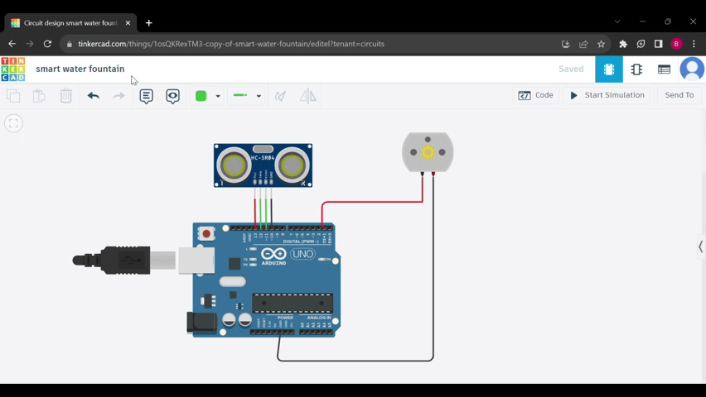

Slide 9
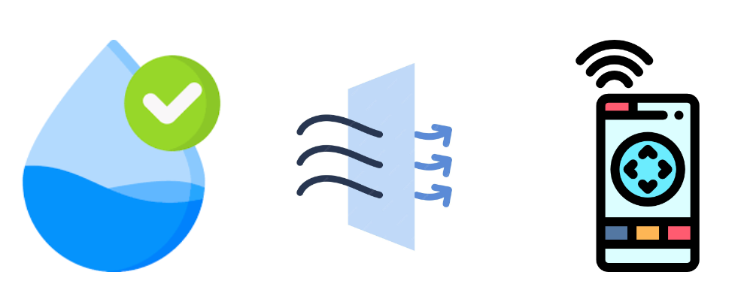
Check the below link to access the overview of smart water fountain:
https://smart-water-fountain.netlify.app/

Slide 10
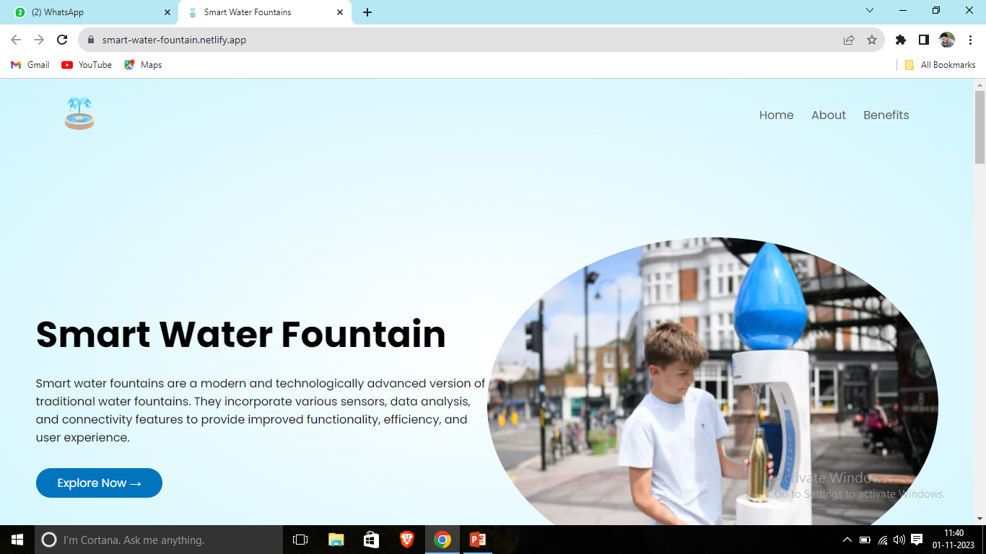
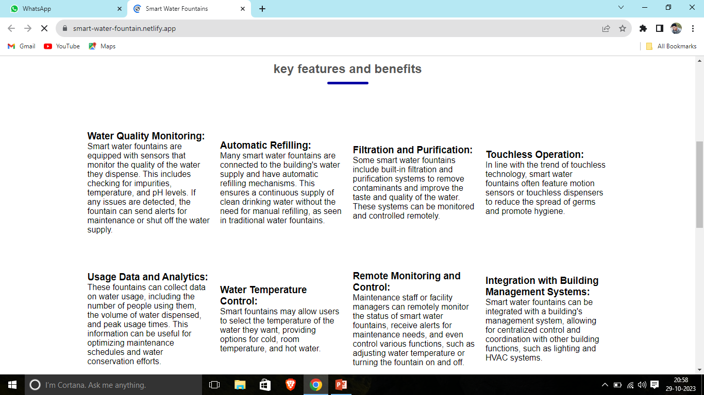
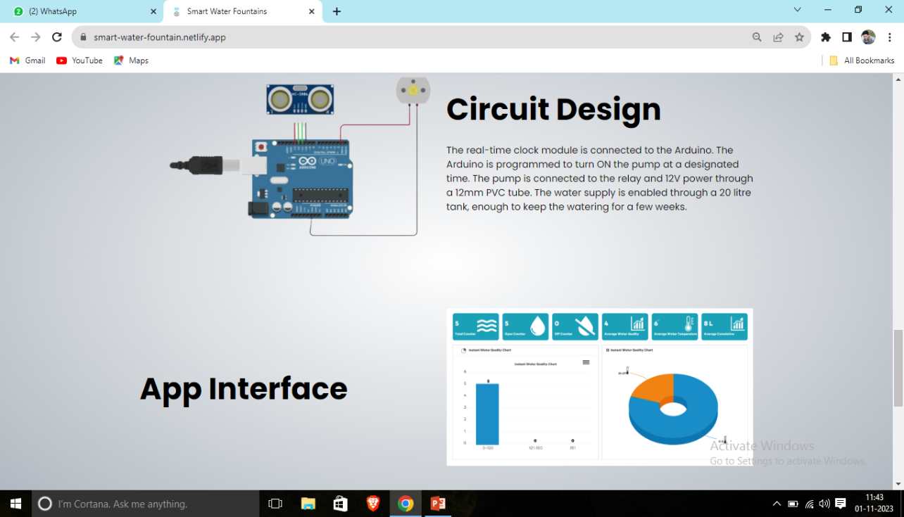
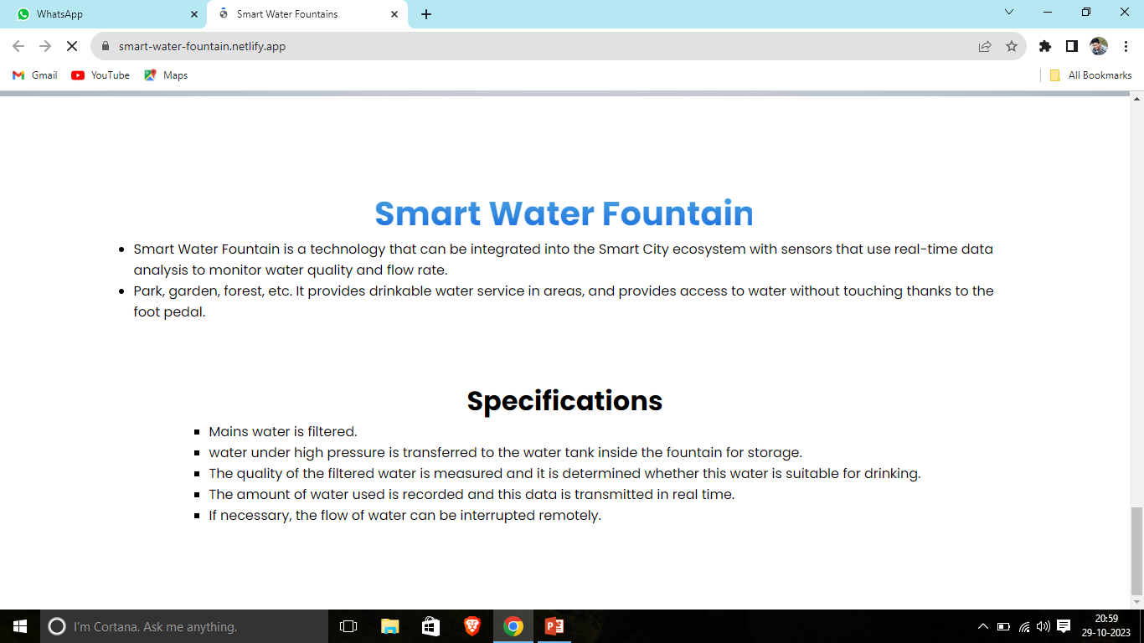
SCREENSHOT OF THE WEBSITE

Slide 11
CONCLUSION
smart water fountains represent a blend of technology and artistry that offers numerous benefits in terms of aesthetics, functionality, and sustainability. These fountains leverage a range of technologies, including Digital-to-Analog Converters (DACs), Internet of Things (IoT) integration, and Computer-Aided Design (CAD), to create captivating water features that can be customized, automated, and remotely controlled.
The implementation of smart water fountains requires expertise in design, electrical and mechanical engineering, software development, and a commitment to adhering to safety and environmental regulations. Whether used in public spaces, private residences, or commercial settings, these fountains offer a dynamic and captivating element that enriches the overall experience of water features. The future of smart water fountains holds the promise of further innovation and creativity, with the potential to enhance our living spaces and urban environments in both aesthetic and functional ways.

Slide 12
THANK YOU!

